Slide 1

Supply Chain Data Analysis: Insights from the DataCo SMART Dataset
Understanding Shipping, Sales, and Customer Behavior
Date: May 13, 2025

Slide 2




Introduction
Objective
Why This Matters
To analyze the DataCo SMART Supply Chain Dataset to uncover insights into shipping performance, sales trends, customer behavior, and geographical patterns.
Supply chain optimization can reduce costs, improve delivery times, and enhance customer satisfaction, directly impacting business profitability.
Approach
Leverage Python pandas and SQL within Jupyter Notebook for data analysis and visualization.

Slide 3

Dataset Description
Source
DataCo SMART Supply Chain Dataset from Kaggle
Size
Approximately 180,000 rows and 53 columns
Shipping Details
Order Details
Days for shipping (real), Days for shipment (scheduled)
Order Id, order date (DateOrders), Order Status
Shipping Mode, Delivery Status
Order Item Quantity, Sales, Order Profit Per Order
Product & Geographical Details
Customer Details
Product Name, Category Id, Product Price
Customer Id, Customer Segment
Latitude, Longitude, Market, Order Region
Customer City, Customer Country

Slide 4





Analysis Objectives
Shipping Performance
Sales and Profit Trends
Customer Behavior
Evaluate shipping efficiency and identify delays.
Understand sales patterns and profitability over time.
Analyze repeat purchases and segment behavior.
Product Insights
Geographical Patterns
Identify top-performing products and categories by sales and profit.
Locate high-order-volume regions and assess the impact of distance on shipping delays.

Slide 5




Methodology
Data Cleaning
Handle missing values, convert order date (DateOrders) to datetime, verify column consistency.
Exploratory Analysis
Compute averages, counts, and percentages (e.g., shipping delays, repeat purchase rates).
Visualization
Generate charts and geographical maps using Python and Tableau.

Slide 6
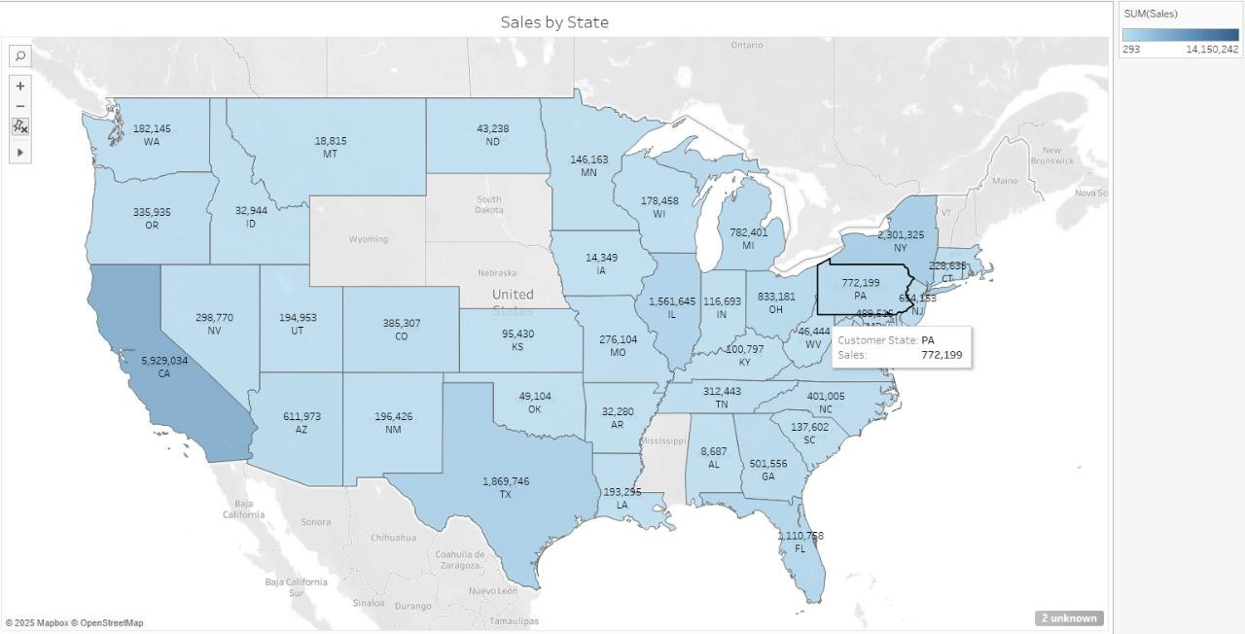
Tableau Charts

Slide 7
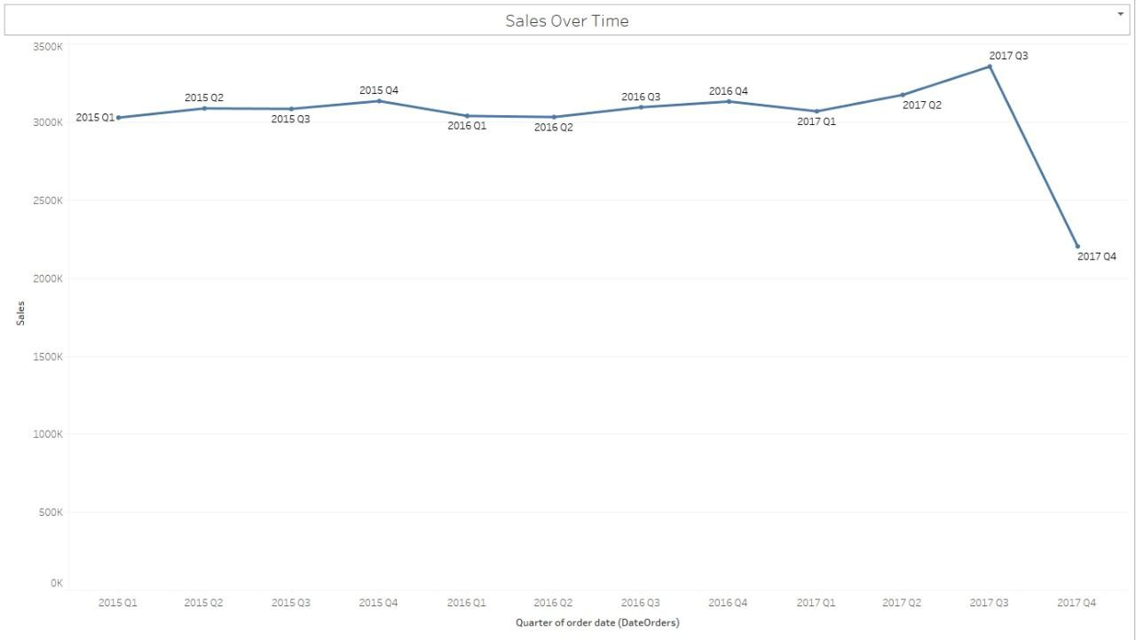
Tableau Charts

Slide 8
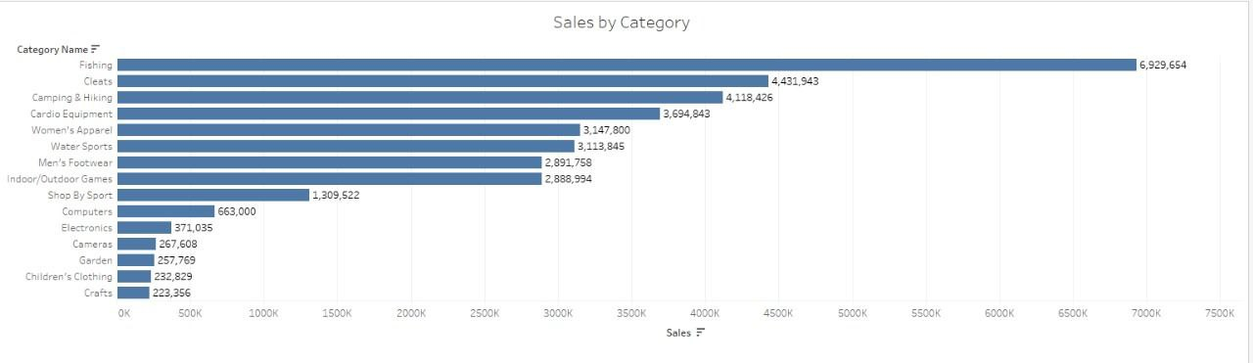
Tableau Charts

Slide 9
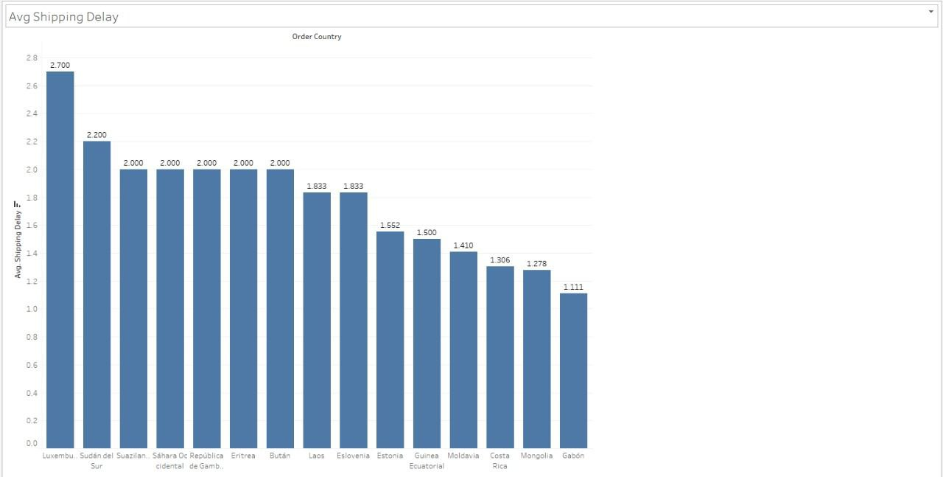
Tableau Charts

Slide 10
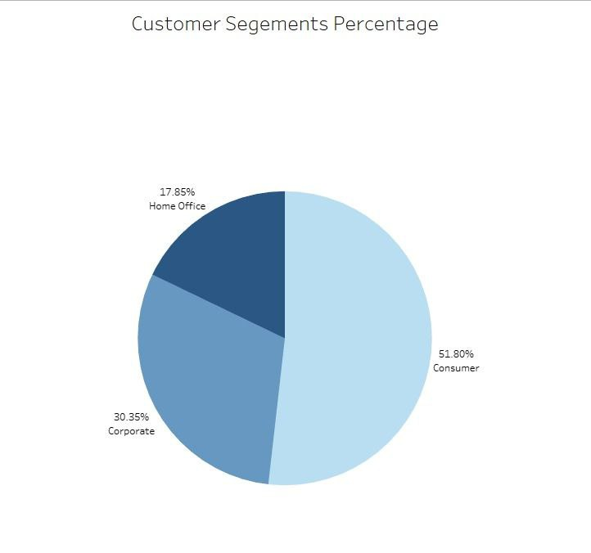
Tableau Charts

Slide 11
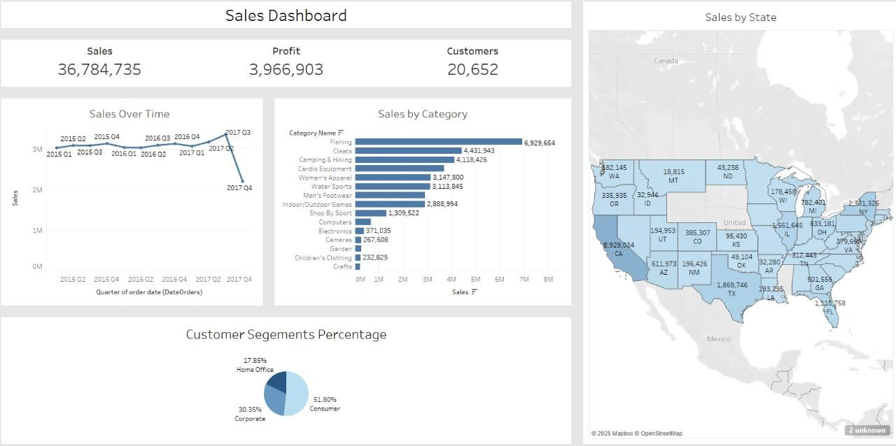
Dashboard

